Slide 1
Prof.邵继荣
Tel: 13815412780
QQ group: 1021893398
教学立方：H3QBQ9EN

Slide 2
English Teaching at NJU
Listening & Speaking
Reading & Writing

Slide 3
College English: Listening & Speaking
(level three)
依据《大学英语教学指南》和南京大学“一核、两端、三元、四维”的人才培养新体系，确定本课程的教学目标融“德、知、行”（即育人、传授知识、培养能力）三元一体，即以培养学生的英语应用能力，尤其是英语听说能力为核心，同时通过融入思政教育、人文教育等，培育学生强烈的家国情怀，树立世界眼光，提升综合素养。

Slide 4
Teaching Objective 教学目标
听力：能听懂就日常话题展开的简单英语交谈；
能听懂用英语讲授的相应级别的英语课程；
能基本听懂语速较慢(每分钟130 ~150 词)的音视频材料和 题材熟悉的讲座，掌握中心大意，抓住要点。
能养成良好的听音习惯，运用基本的听力技巧。
口语：掌握常用的语音知识，能流利准确地朗读短文。
能就日常话题用英语进行简短但多话轮的交谈；能对一般性事件和物体进行简单的叙述或描述；经准备后能就所熟悉的话题作简短发言；能就学习或与未来工作相关的主题进行简单的讨论。语言表达结构比较清楚，语音、语调、语法等基本符合交际规范。能运用基本的会话技巧。
Level A词汇：四会掌握
增长中外文化知识、提升跨文化交际意识与能力、加
强思辨能力、提高英语应用能力。

Slide 5
Teaching Plan
授课周数：14周
2019年9月24日—2021年1月3日, 包括国庆放假

Slide 6
Teaching Plan
教学材料
●Units 1~5, Textbook One
●南京大学大学英语通用词汇
Level A Words (P84-, textbook)
●recitation (课外朗读背诵短文)

Slide 7
download listening material
课本每个单元的视听资料可供学生下载
下载地址：http://eol.nju.edu.cn/
（课本视听资料的练习答案在每周周五可以下载）

Slide 8
Sept. 29: Course Introduction & Unit 1
Oct. 13: Unit1
Oct. 20: Unit 2
Oct. 27: Unit 2
Nov. 3: Unit 3
Nov. 10: Unit 3
Nov. 17: Unit 4
Nov.24: Unit 4
Dec. 1: Unit 5
Dec.8: Unit 5
Dec. 15: Listening Test
Dec. 22: Speaking Test
Dec. 29: Oral Activities

Slide 9
南京大学大学英语通用词汇（P.84）
A级词汇
会读：掌握可能的不同发音
会拼写：注意名词的复数或动词的不规则变化
会中文意思 （用同义词或英文解释）
会用：造句

Slide 10
朗读背诵
课外短篇（老师每周提供文本和相应的音频）
在模仿语音语调的基础上朗读背诵
学生每周把朗读录音上传至班级QQ群
Or 课上抽查

Slide 11

1 Tongue twister---Mr. cook bought the book
Mr. Cook said to a cook: "Look at this cook-book. It's very good." So the cook took the advice of Mr. Cook and bought the book.
2 Grizzly Bear
If you ever, ever meet a grizzly bear,
You must never, never, never ask him where
He is going,
Or what he is doing.
For if you ever, ever dare
To stop a grizzly bear,
You will never meet another grizzly bear.

Slide 12
6 Steve Jobs’ Commencement Speech at Stanford University, 2008.
I'm convinced that the only thing that kept me going was that I loved what I did. You've got to find what you love.
And that is as true for your work as it is for your lovers. Your work is going to fill a large part of your life, and the only way to be truly satisfied is to do what you believe is great work. And the only way to do great work is to love what you do. If you haven't found it yet, keep looking -- and don't settle. As with all matters of the heart, you'll know when you find it. And like any great relationship, it just gets better and better as the years roll on. So keep looking -- don't settle.

Slide 13
assessment
听力测验20%：课本1~5单元；12月15日统一机考
口语测试10%：与课本听力内容相关话题;12月22日
平时40% (课堂表现、作业、出勤、level A词汇测试)
语音考核10%：小组配音（12月29日课堂展示评比）
停课后综合测试中的听力部分20%（课外内容）

Slide 14
Exams：listening
期末听力课程测试（第15周，即12月15日），
随堂测试，在机房完成，
学生除笔之外，不允许带任何东西到座位上，草稿纸统一发放。
考试范围：《教程1》1至5单元）
考试题型：选择、正误判断、填空（单词和短语）

Slide 15
南京大学大学英语视听说课程听力测验样题
Section One
Directions: In this section you will hear 3 passages. Each passage will be spoken
ONLY ONCE. After you hear the passage, you must choose the best answer from
the four choices marked A), B), C) and D).
1. Why should you not be afraid to pause during a presentation?
A. Because the audience can sneakily have a rest.
B. Because the speaker can plan what to say next.
C. Because pausing can be a drama technique.
D. Because pausing can be a blistering attack.
......
Section Two
Directions: In this section you will hear 2 passages. Each passage will be spoken ONLY ONCE. After you hear the passage, you must decide whether each of the following statements is True, False or Not Given. Write “T” for true, “F” for false, or “NG” for not given.
1. According to the speaker, you should always have faith in yourself. （ ）
......
Section Three Directions: In this section you will hear 2 passages. Each passage will
be spoken TWICE. After you hear the passage, you are required to fill in the
blanks with the exact words you have just heard.
I’m Carmine Gallo. And today I’ll walk you through several key techniques that Steve Jobs uses to (1) __________________ his audience, ......

Slide 16
Exams: speaking
期末口语课程测试：
第16周（12月22号）；随堂考
学生抽取话题，就所给话题表达自己的观点
话题基于学本期的授课内容。
评分点：准确性、复杂度、连贯性、
逻辑条理、自信度

Slide 17
南京大学大学英语视听说课程口语测验样题
In unit 1, we have learnt how students raise money for charity
in Britain. Your teacher will ask a few questions regarding this topic, and you are to give your response for about 2 minutes.
Questions: Have you ever raised money for charity?
What are the ways Chinese college students do the charity?
Can you list 3 ways that you have done or heard of?
In addition, if you were asked to organize a charity event, what would you do? (Please describe who would be sponsored and how this event would be done.)

Slide 18
学期末停课后 综合测试中的 听力部分

Slide 19
语音考核(必做，占最后总成绩10%)：
小组配音 （12月29日课堂）
自选材料；时长3-5分钟；2-4人一组
（选做：个人配音；2-4分钟，12月20前提交）

Slide 20

Improve your pronunciation and spoken English
“英语趣配音”
●每日更新电影、美剧、动漫、歌曲等丰富类型英文视频。可以通过模仿原声锻炼英语口语，并录制生成个性配音作品。
●可以通过设定英语水平、管理视频模块等改变首页推荐，最快找到适合你的视频学习资源、高效率地学习口语。
●……

Slide 21
Requirements
Before class: preview new words
On class: listen attentively & be active
After class: review & do homework
观看微课视频
homework: Level A words
reading-aloud & recitation
listening exercises

Slide 22
after-class listening practice
www.tingclass.net 每日英语听力
www.putclub.com 普特
www.listeningexpress.com 听力快车
www.hujiang.com 沪江
…

Slide 23
微信公众号
CNN学生英语新闻 (FancyEnglish)
●薄荷阅读 (MintReading)
●芝士派 (CheesePie)
● 友邻优课 (YLYK)

Slide 24
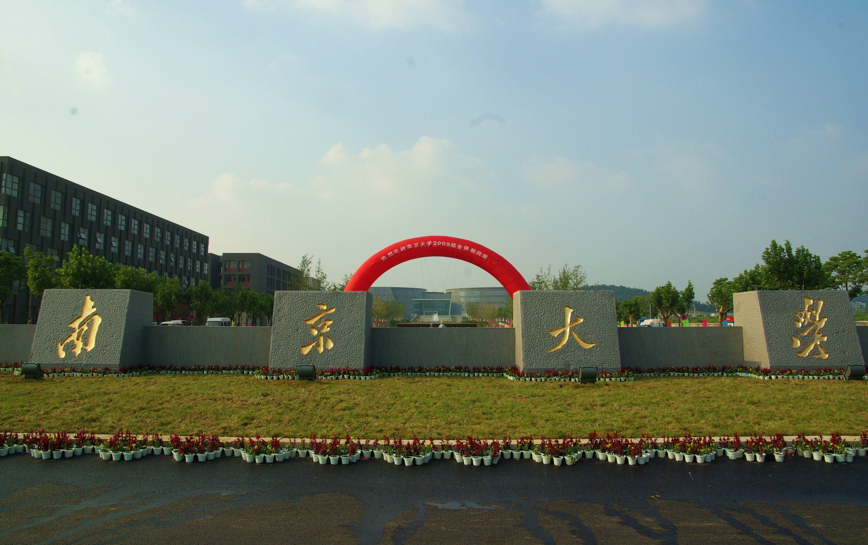
Why NJU？
What factors did you take into consideration when deciding which university you were going to study in?

Slide 25

What are the factors that James considered when choosing a college for his daughter?
According to him, what was the most important factor?

Slide 26
distance from home
campus safety
academics

Slide 27
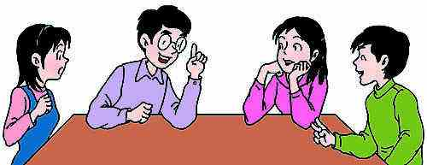
groups
●Form groups of 4 or 6.
● Select a group leader.
● Discuss with each other to get
a name for your group.

Slide 28

Group Presentation
● The group leader introduces the name of the group and explains why such a name is chosen.
● All the group members take turns to present “Something about Me”.

